Slide 1
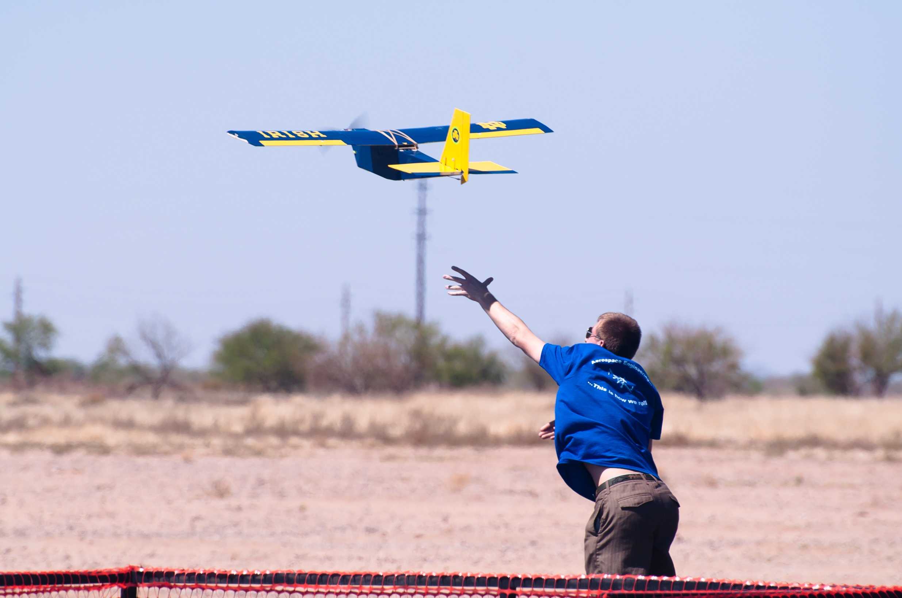
FOM Analysis Design, Build, Fly!
9/15/13

Slide 2
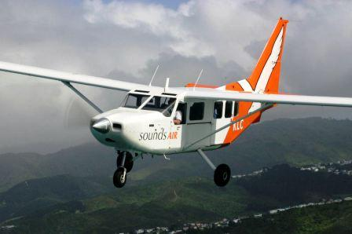
Missions Review
Backcountry Rough Field Bush Plane
Pre-Flight Rough Field Taxi Mission
Mission 1 – Complete as many laps as possible in 4 minutes
Mission 2 – 3 lap max load flight – 6”x6”x6” wood blocks
Mission 3 – Emergency Medical Mission – 3 lap, prescribed load
Competition in Wichita, KS

Slide 3
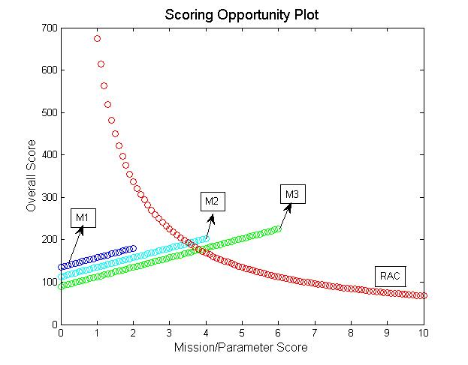
Scoring Analysis Conclusions

Slide 4
Design Drivers
Scoring Analysis Conclusions
Sample Competition Scenarios
Fast and Light Plane
M1 = 1.7 – M2=1.5 – M3=5.8
RAC=2.5
Final Score = 324
Primary: Empty Weight
Secondary: Speed
Large Towing Capacity
M1 = 1.1 – M2=4 – M3=4
RAC=4
Final Score = 204.75 -- (if RAC=5, Score=163.8)
Renaissance Plane
M1 = 1.45 – M2=3 – M3=5
RAC=3.5
Final Score = 243.00

Slide 5
Figure of Merit Weights
 | Weight | High Lift/Short TO | Glide Capability | Size | Ease of Construction | Stability & Control | Payload Capability | Totals | Weight (%)
Weight | 0 | 3 | 2 | 4 | 4 | 4 | 4 | 23 | 18.25
High Lift/Short Takeoff | 3 | 0 | 2 | 2 | 2 | 1 | 3 | 12 | 9.5
Glide Capability | 4 | 4 | 0 | 4 | 5 | 3 | 5 | 24 | 19.06
Size | 2 | 4 | 2 | 0 | 2 | 2 | 2 | 14 | 11.12
Ease of Construction | 2 | 4 | 1 | 4 | 0 | 1 | 2 | 14 | 11.12
Stability & Control | 2 | 5 | 3 | 4 | 5 | 0 | 4 | 23 | 18.25
Payload Capability | 2 | 3 | 1 | 4 | 4 | 2 | 0 | 16 | 12.7
 |  |  |  |  |  |  |  | 126

Slide 6
Figure of Merit Weights
Figure of Merit | Weight (%)
Weight
Short-Take Off/High Lift
Speed
Size
Payload Capability
Stability & Control
Ease of Construction

Slide 7
Wing Configuration
Wing Configuration | Weight (%) | Monoplane | Biplane | Tandem Wing / Canard | Flying Wing / Blended Body
Weight | 18.25 | 4 | 3 | 3 | 5
High Lift/Short Takeoff | 9.5 | 3 | 4 | 3 | 3.5
Speed | 19.06 | 4 | 2 | 3 | 4.5
Size | 11.12 | 3 | 1 | 3 | 4
Ease of Construction | 11.12 | 5 | 2 | 2 | 1
Stability & Control | 18.25 | 4.5 | 3 | 2 | 1
Payload Capability | 12.7 | 3 | 3 | 3 | 1.5
Total | 100% | 3.87 | 2.57 | 2.71 | 3.03

Slide 8
Motor Configuration
Motor Configuration | Weight (%) | Mono Tractor | Mono Pusher | Twin Tractor | Twin Pusher | Tractor & Pusher
Weight | 18.25 | 4 | 4 | 2 | 2 | 2
High Lift/Short Takeoff | 9.5 | 4 | 2 | 5 | 1 | 2
Speed | 19.06 | 4 | 3 | 5 | 4 | 4
Size | 11.12 | 3 | 3 | 2 | 2 | 2
Ease of Construction | 11.12 | 5 | 3 | 2 | 1 | 1
Stability & Control | 18.25 | 4 | 2 | 3 | 1 | 1
Payload Capability | 12.7 | 3 | 3 | 3 | 3 | 3
Total |  | 3.87 | 2.86 | 3.17 | 2.12 | 2.21

Slide 9
Tail Configuration
Empennage Configuration | Weight (%) | Conventional Tail | V-Tail | Single Vertical Stabilizer | Winglets
Weight | 18.25 | 4 | 4 | 3 | 5
High Lift/Short Takeoff | 9.5 | 5 | 5 | 1 | 2
Speed | 19.06 | 3 | 4 | 3 | 4
Size | 11.12 | 3 | 3 | 4 | 5
Ease of Construction | 11.12 | 5 | 2 | 5 | 5
Stability & Control | 18.25 | 5 | 2 | 1 | 1
Payload | 12.7 | 3 | 3 | 3 | 3
Total | 100% | 3.96 | 3.27 | 2.78 | 3.54

Slide 10
Landing Gear Configuration
Landing Gear Configuration | Weight (%) | None | Trike | Skids | Retractable | Tail Dragger | Mono Wheel
Weight | 18.25 | 5 | 3 | 4 | 1 | 3.5 | 4
High Lift/Short Takeoff | 9.5 | 1 | 3 | 1 | 3 | 3 | 2
Speed | 19.06 | 5 | 3 | 4 | 3.5 | 3.5 | 4
Size | 11.12 | 5 | 3 | 3 | 1 | 3.5 | 3
Ease of Store Construction | 11.12 | 5 | 5 | 3 | 1 | 4 | 3
Stability & Control | 18.25 | 0 | 5 | 1 | 3 | 2 | 1
Total | 100 | 3.07 | 3.2 | 2.4 | 1.9 | 2.8 | 2.5

Slide 11
Control Surface Configuration
Control Surface Configuration | Weight (%) | 2x Ailerons, 2x Elevator, 2x Flaps | 2x Ailerons, 1x Elevator, 2x Flaps | 2x Ailerons, 2x Elevator | 2x Elevons
Weight | 13.10 | 1 | 2 | 3 | 5
High Lift/Short Takeoff | 9.52 | N/A | N/A | N/A | N/A
Glide Rate | 16.67 | 3 | 3 | 3 | 3
Size | 9.52 | N/A | N/A | N/A | N/A
Ease of Construction | 9.52 | N/A | N/A | N/A | N/A
Stability & Control | 14.88 | 5 | 4 | 4 | 2
Payload Capability | 10.12 | N/A | N/A | N/A | N/A
Climb Rate | 16.70 | 5 | 5 | 5 | 4
Total | 100% | 3.5 | 3.5 | 3.75 | 3.5

Slide 12
2013-2014
University of Notre Dame
AIAA DBF
Faculty Advisor
TBD
Pilots
Terry Rensberger
Paul Distler
Graduate Advisors
Annie Legault
Tamuto Takakura
Team Leads
Harrison Yates
Eliseo Miranda
Report Lead
Eliseo Miranda/Harrison Yates
Aerodynamics Lead
Kate Disser
Structures / CAD Lead
Keldan Mulvey
Propulsion / Electronics Lead
Joshua Vahala
Construction/Testing Lead
Tom Paulius
TBD
TBD
TBD
TBD
TBD

Slide 13
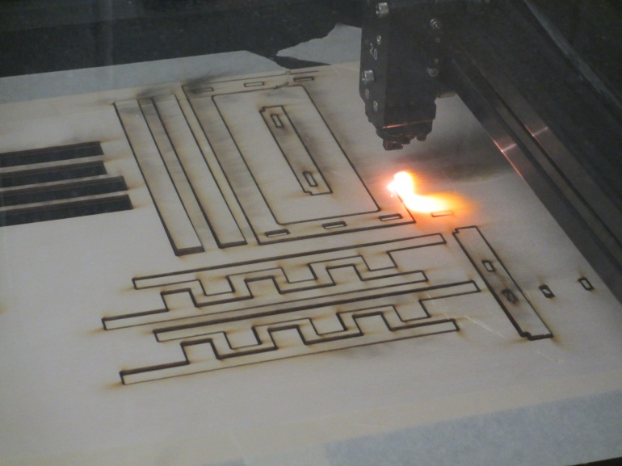
Organization
All students now have 50GB worth of cloud storage within Box
https://notredame.box.com/files
Invites to the DBF “Box” will be sent shortly
Used for all team data storage (Report files, CAD files, pictures, etc.)
Machine Shop Training
Laser Cutter, Safety, 3D Printer
Weekly Meetings
Sunday @ 4:30pm
Stinson-Remick 109

Slide 14
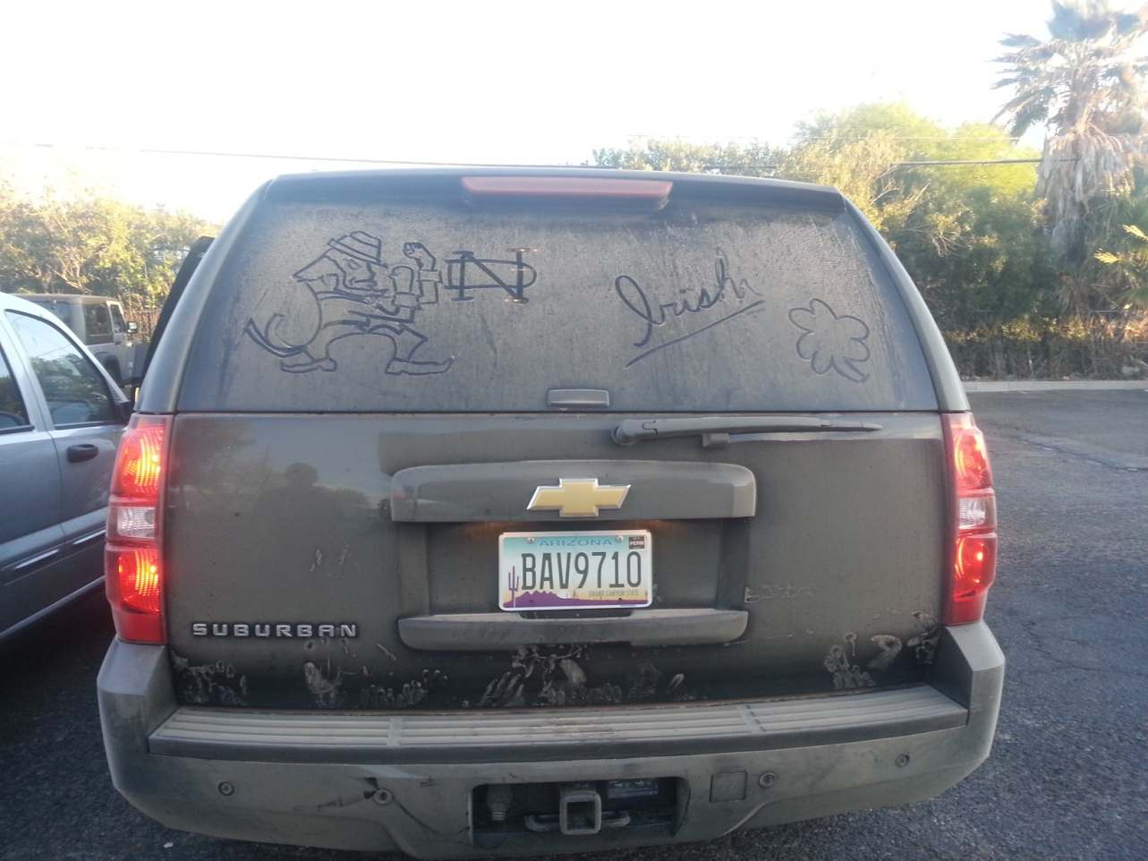
Notre Dame Design/Build/Fly
Questions?

